Slide 1
Angular concept
Presented by E.Divya

Slide 2
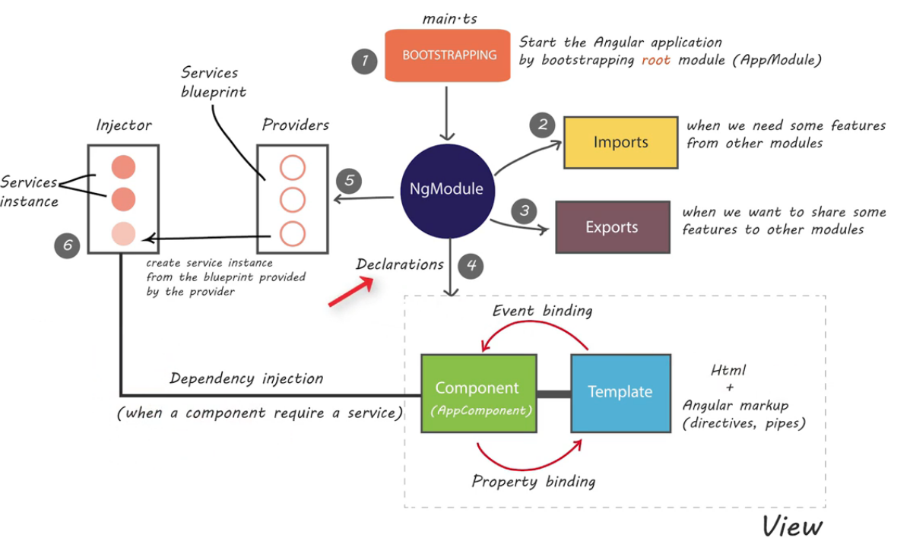
Angular Architecture

Slide 3
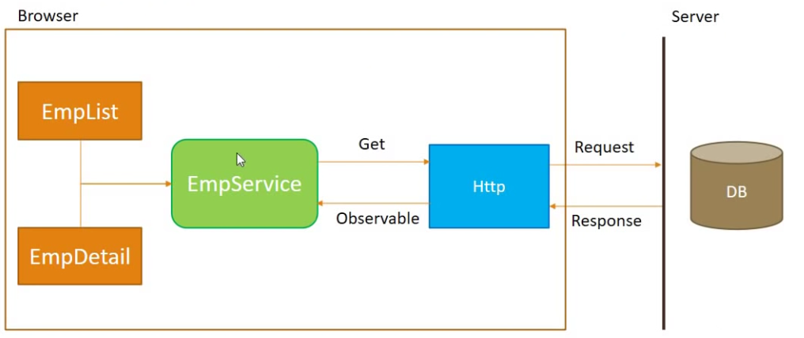
Http mechanism

Slide 4
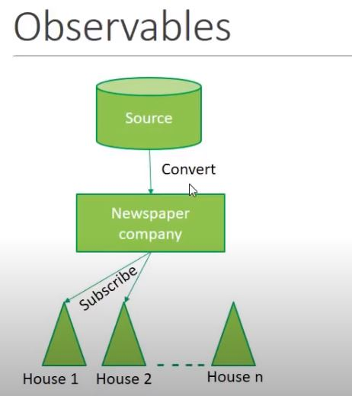

Slide 5
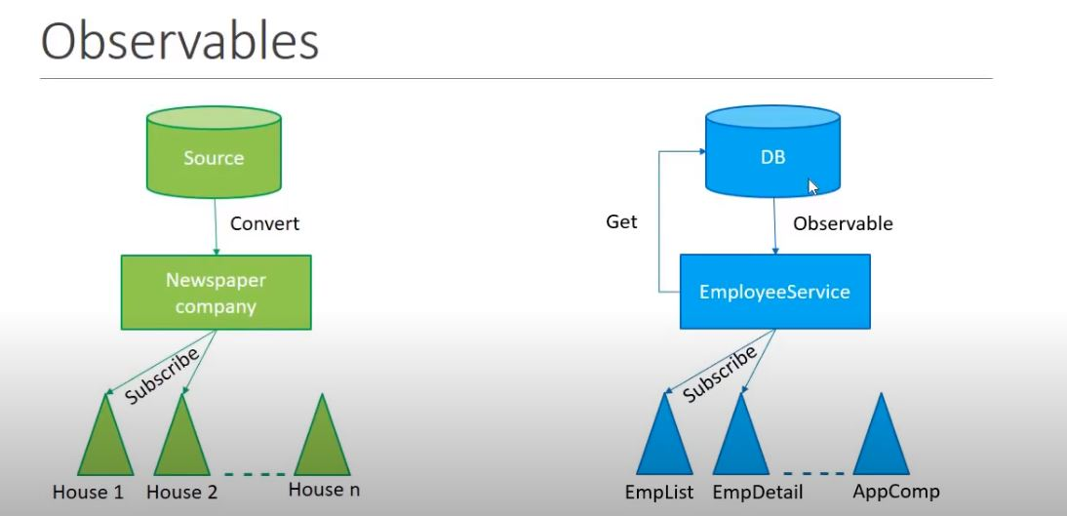

Slide 6
Ajax
Ajax stands for Asynchronous JavaScript and XML.
It is used to request data from the server without full-page refresh, and use the result, which was originally XML, to re-render a part of the page.
Modern libraries and frameworks, like Angular, make building SPAs simpler.
Responses from the server in Ajax are handled in the form of callbacks.

Slide 7
Implementation of Ajax in application
Create an XMLHttpRequest Object.
Making a request to the server.
Handling the response coming from the server.​
Send the request.

Slide 8
THANK YOU

